Slide 1
Real-time Speech to Text to Speech : Building Your AI-Based Alexa - using Google's gTTS for Text-to-Speech
Jubaida Tasnim

Slide 2
Table of Content
Introduction
Design
Why this approach?
Problem identification and solution selection
Implementation
Steps and tools used
Test
Code and Results
Enhancement Ideas
Conclusion

Slide 3
Introduction
Purpose: Building an AI-based voice assistant that integrates real-time speech-to-text and text-to-speech with OpenAI GPT.
Key Components:
Whisper for transcription
OpenAI for conversational replies
gTTS for voice responses

Slide 4
Design
Why this approach?
Identify Problems:
Need for an accurate and responsive voice assistant.
Challenges in transcription, response generation, and voice playback.
Investigate Possible Solutions:
Explore Whisper for transcription, OpenAI for GPT responses, and gTTS for TTS conversion.
Consider other libraries and APIs but focus on accuracy and simplicity.
Compare and Select Best:
Whisper for its superior transcription accuracy.
OpenAI GPT for state-of-the-art conversational abilities.
gTTS for straightforward TTS conversion.

Slide 5
Implementation
How this was achieved?
Audio Recording:
Capture user’s speech with speech_recognition.
Convert audio into tensors using PyTorch.
Speech-to-Text (Whisper):
Use Whisper’s base model for transcription.
Text Processing (OpenAI GPT):
Process queries and generate intelligent responses.
Text-to-Speech (gTTS):
Convert the generated text to speech and play the audio.

Slide 6
Test
Testing the Implementation
Setup:
Run the program in a terminal with click options.
Example command: bash python app.py --model base --wake_word "hey computer"
Scenarios:
Speak commands prefixed with the wake word.
Validate transcription accuracy.
Verify meaningful responses and audio output

Slide 7
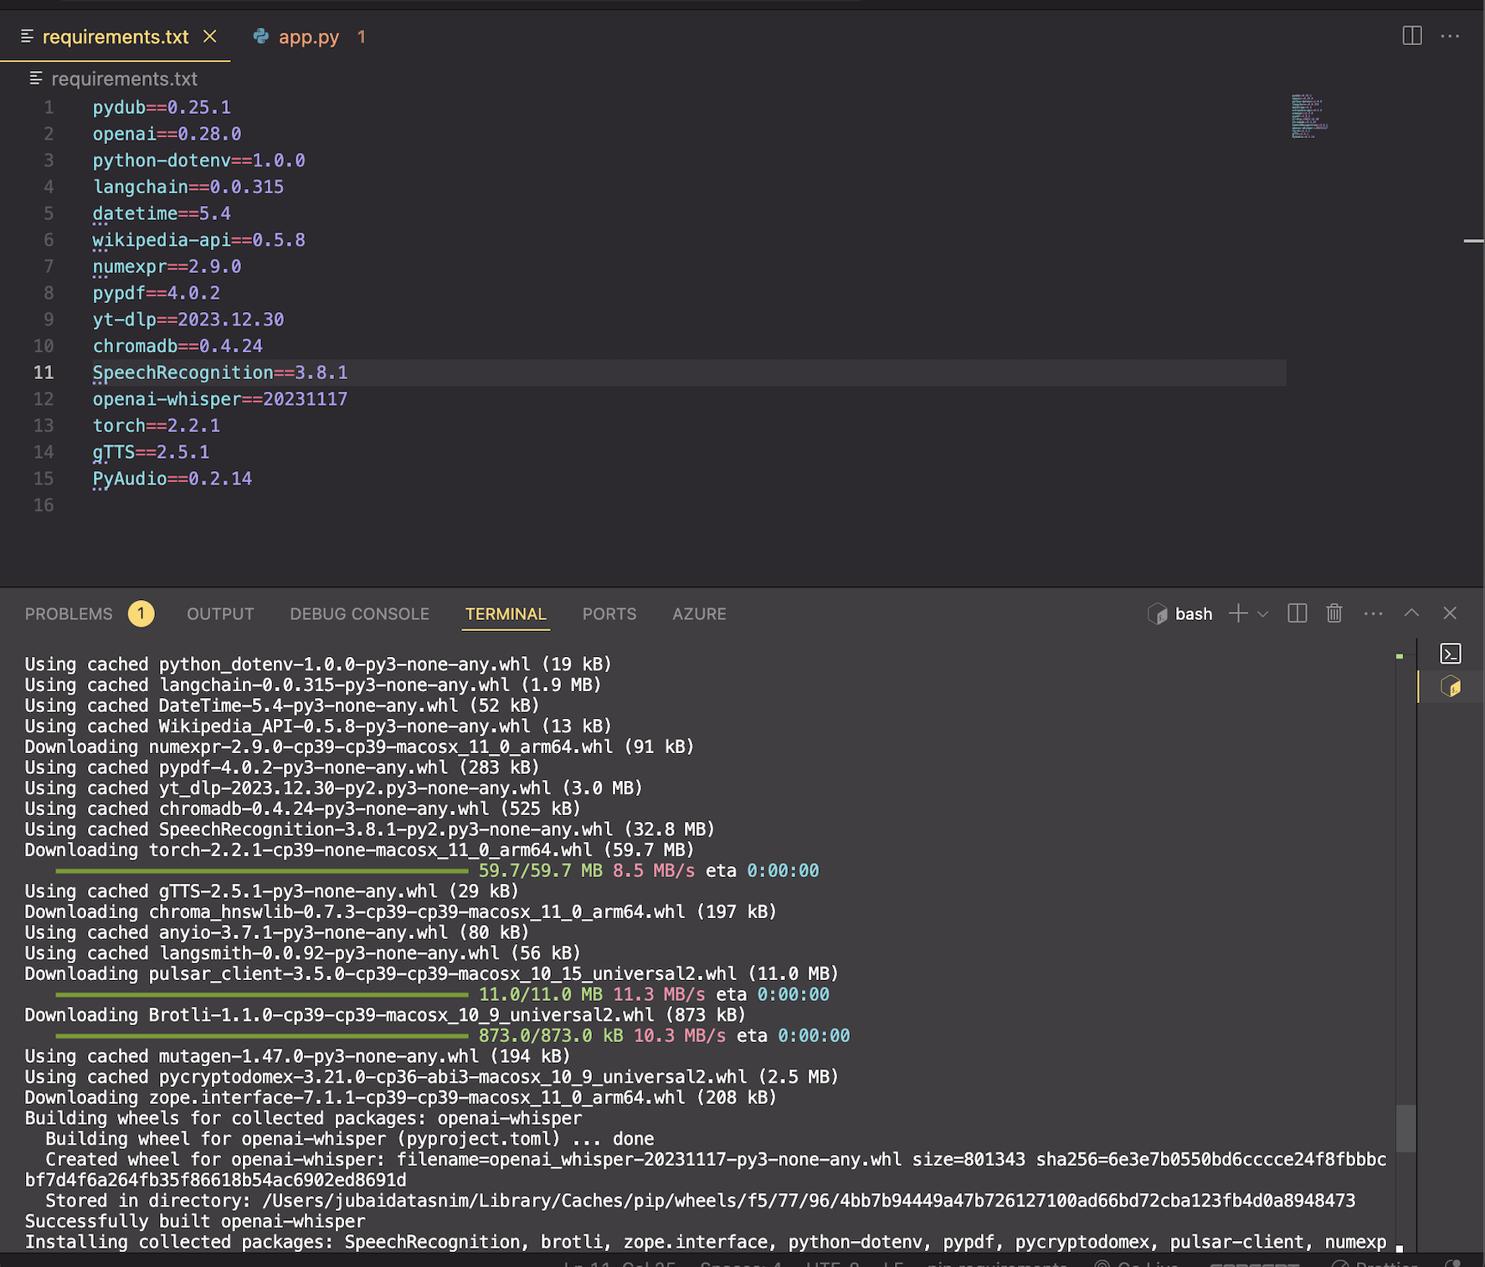
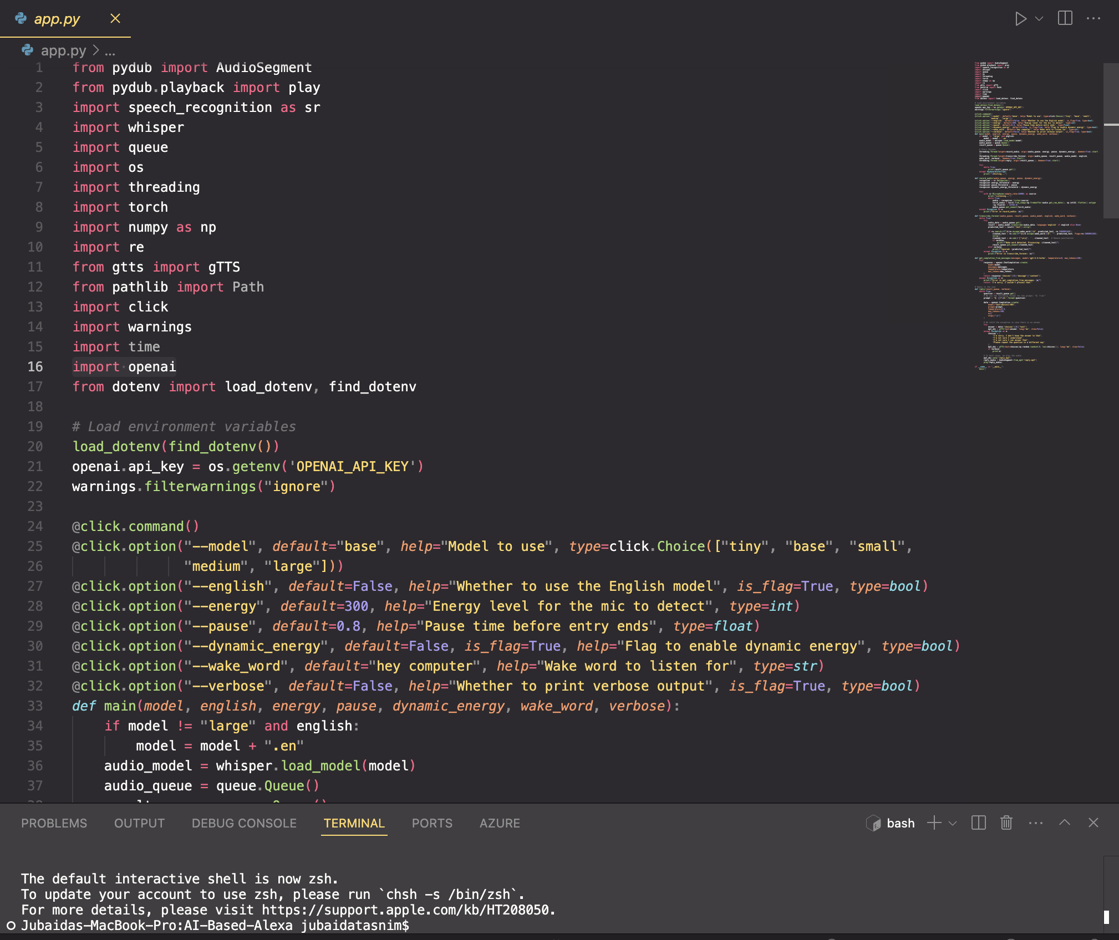
Code and Results

Slide 8
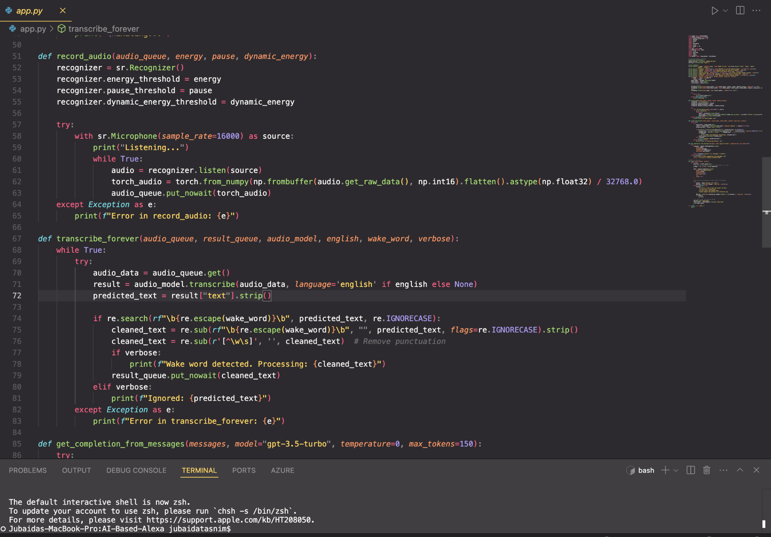

Slide 9
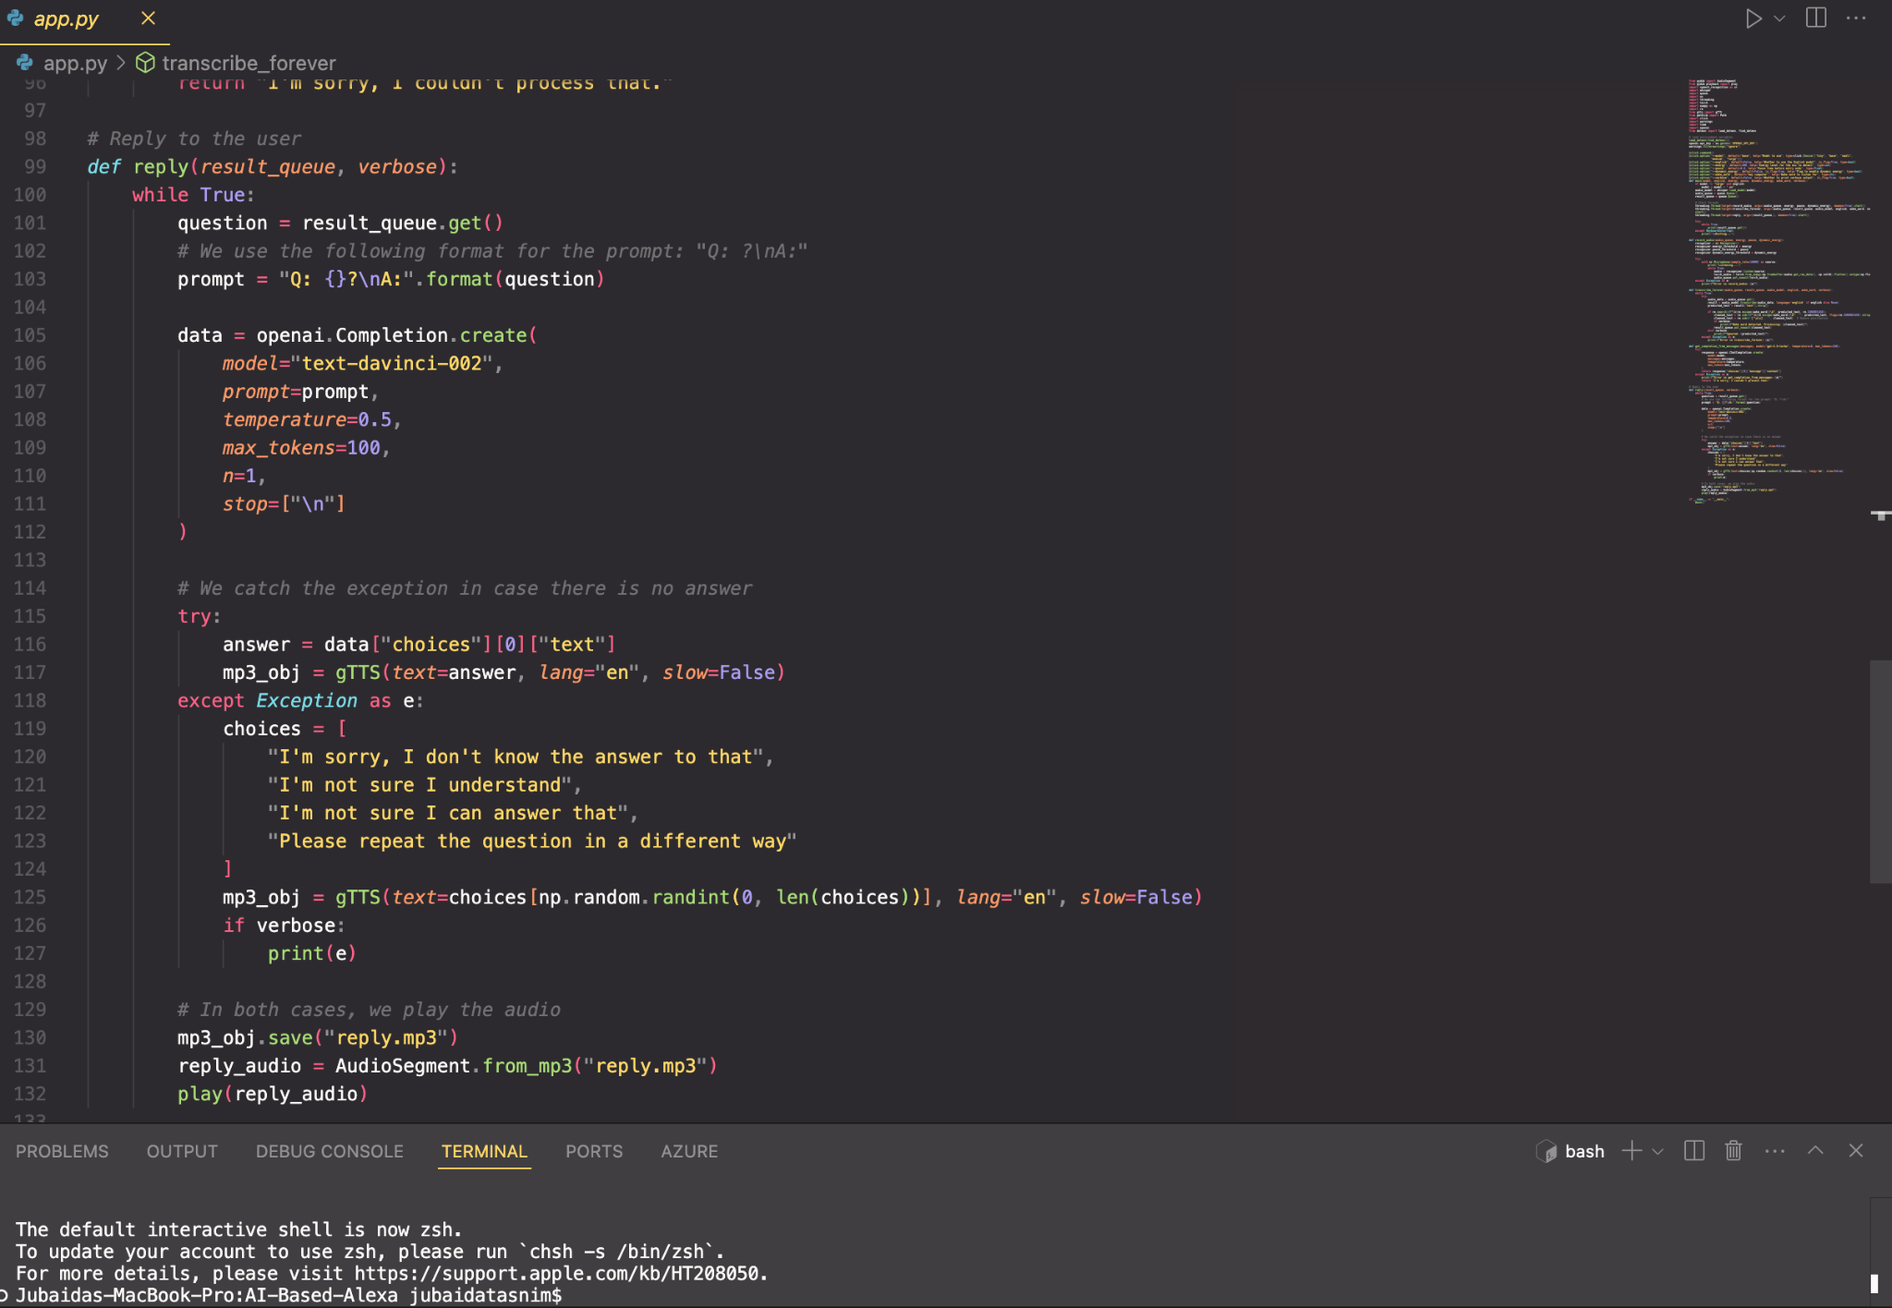

Slide 10
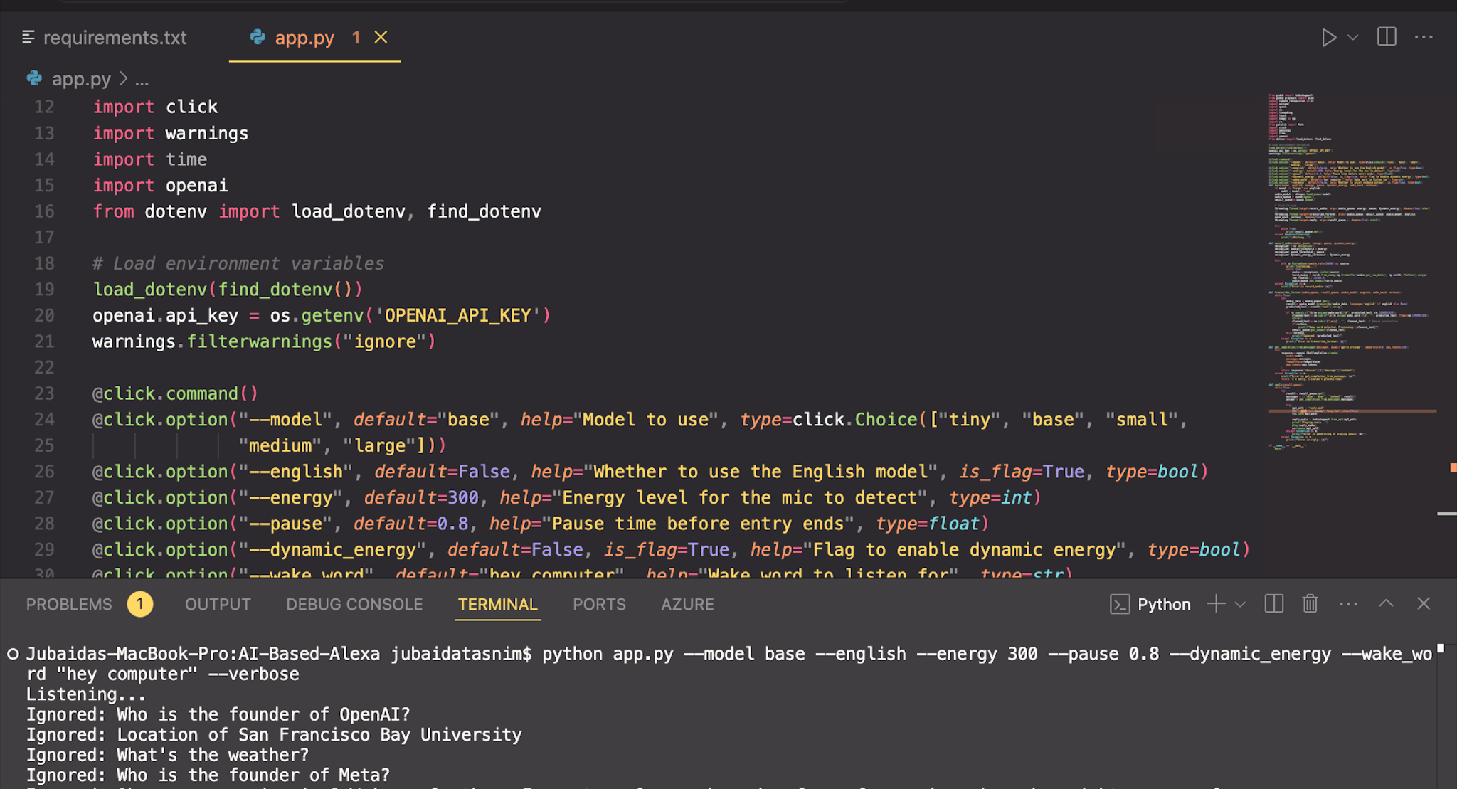

Slide 11
Enhancement Ideas
Improve Text-to-Speech:
Replace gTTS with OpenAI Text-to-Speech for higher quality.
Add Multilingual Support:
Extend transcription and responses to other languages.
Enrich Functionality:
Integrate with external APIs (e.g., Google Calendar).
Allow voice-triggered controls for smart devices.

Slide 12
Conclusion
Outcome: Successfully built a real-time, conversational AI-powered voice assistant.
Future Scope:
Enhance interactivity and capabilities.
Address real-world challenges like background noise and latency.

